Slide 1

STARTING SMART
          WITH
LEARNING RESOURCES
April 7, 2016

Slide 2

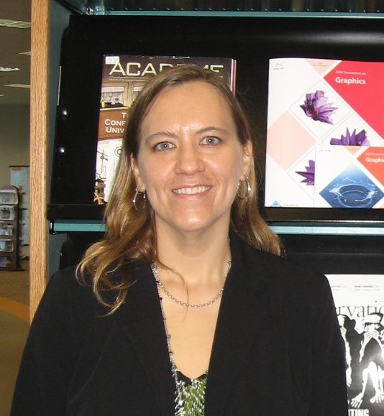
Presenters
Matthew Bodie
Associate Director, Learning Resources
St. Petersburg College, Clearwater
bodie.matthew@spcollege.edu
Jennifer Gregor
Library Program Director
St. Petersburg College, Seminole
gregor.jennifer@spcollege.edu
Notes:
Both been with the college about 8 years

Slide 3
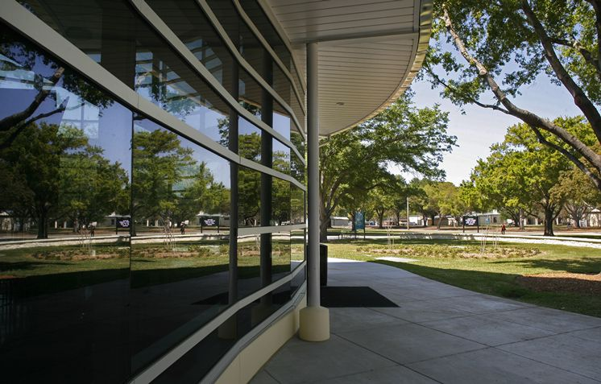
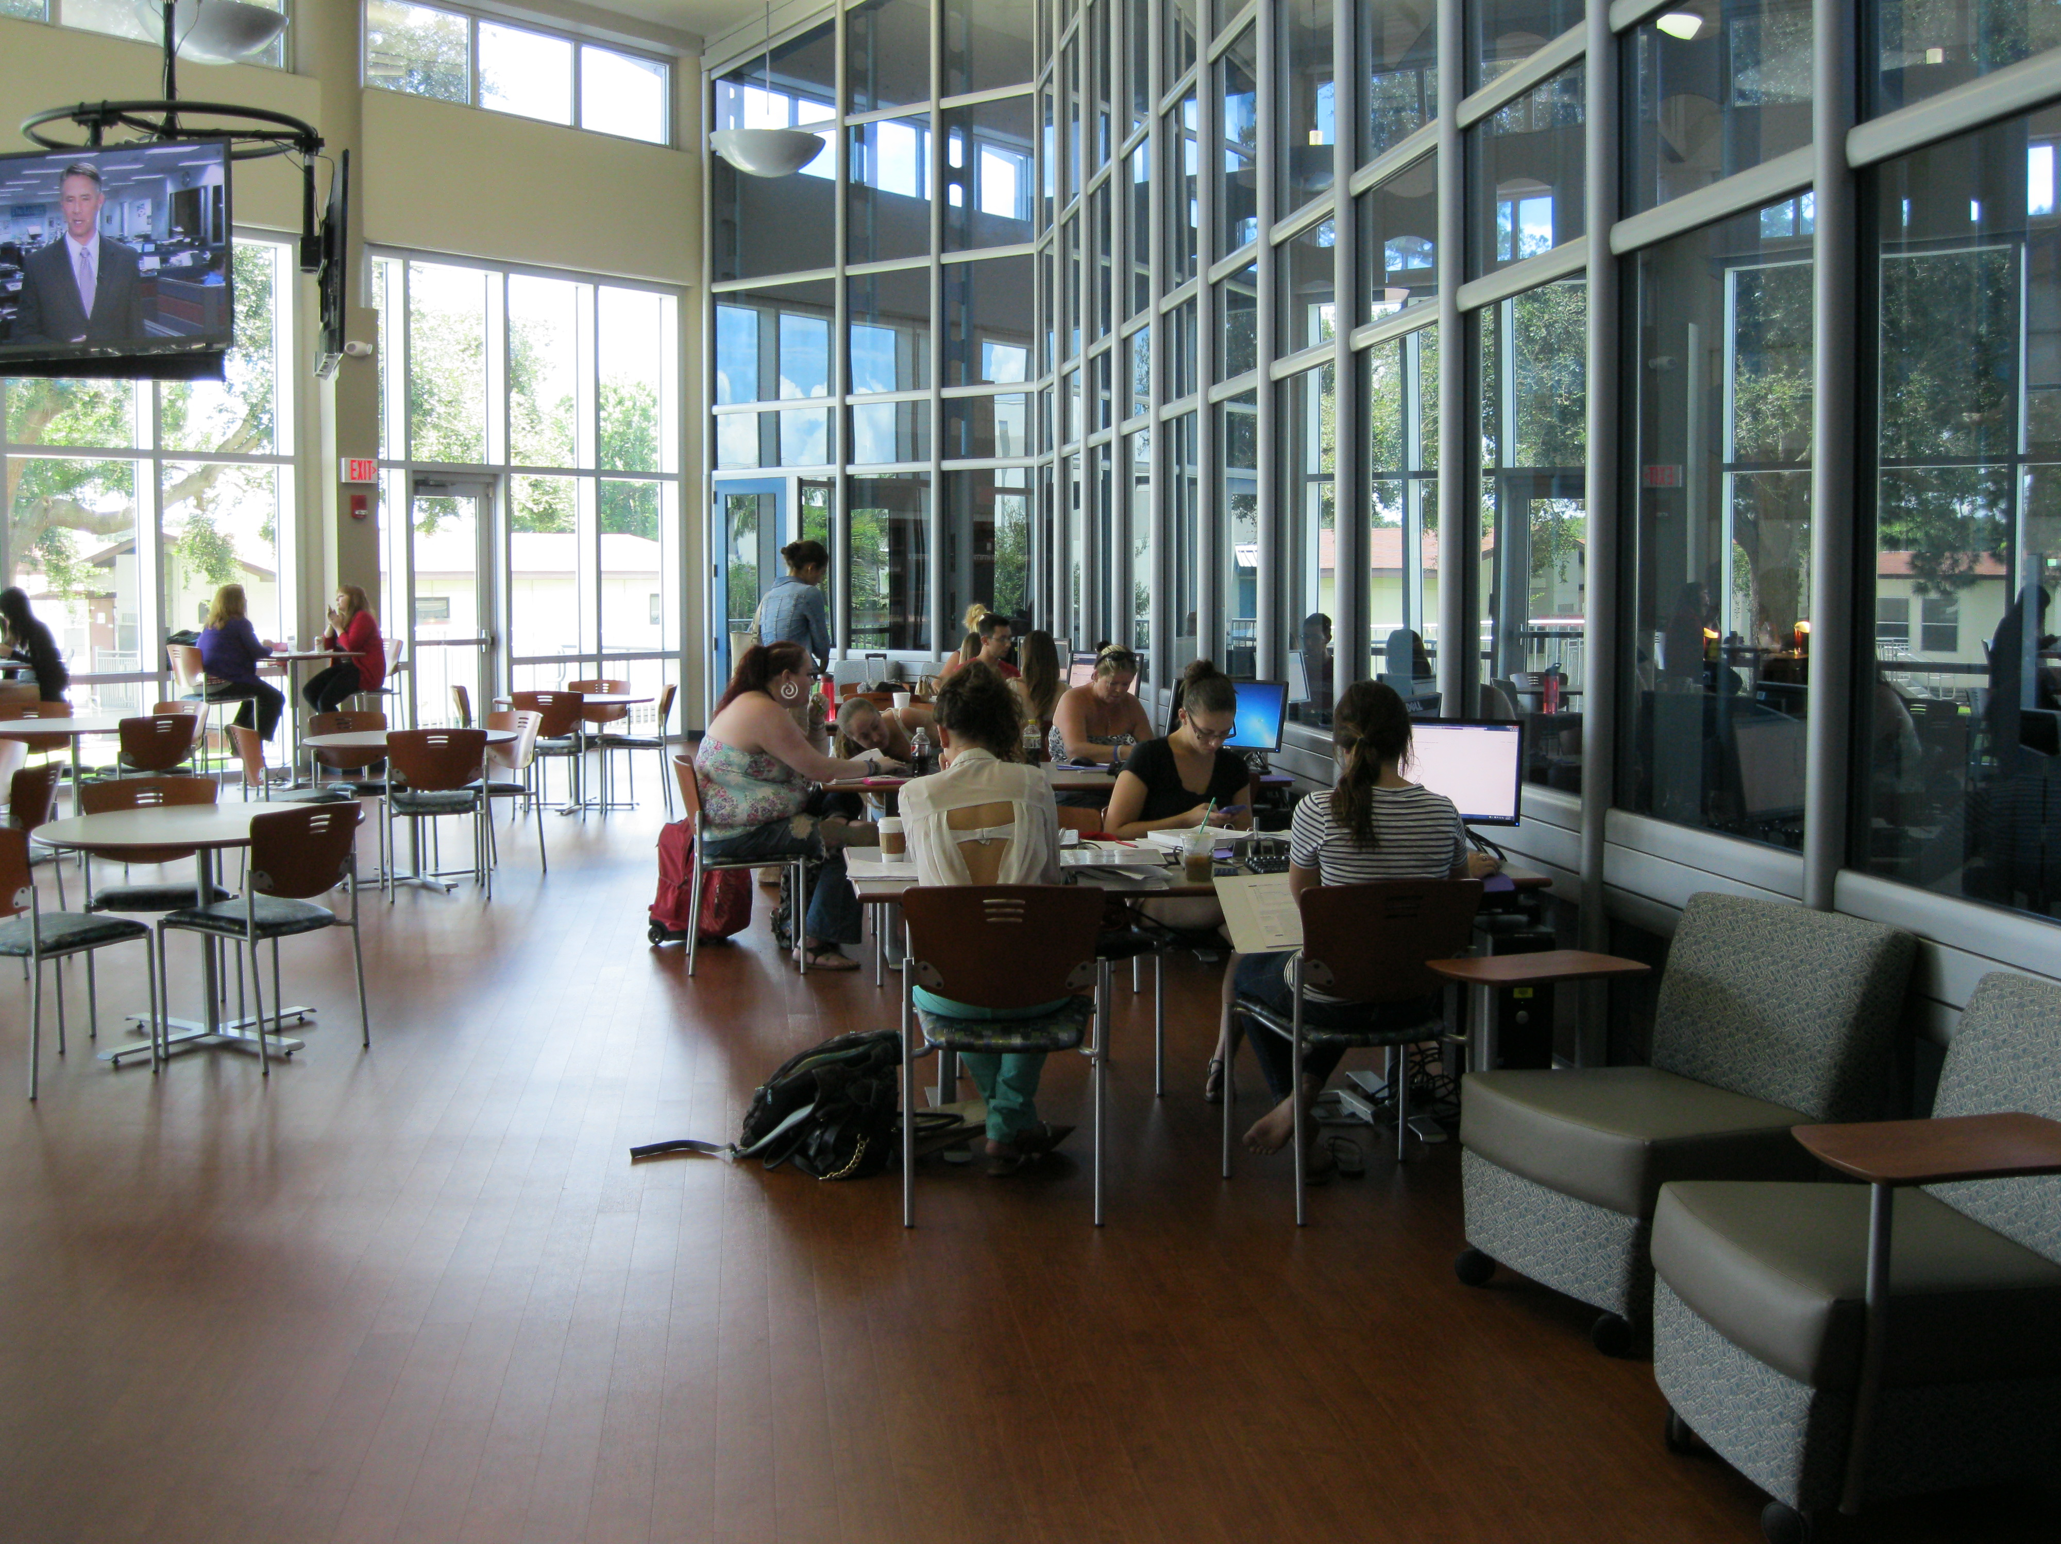
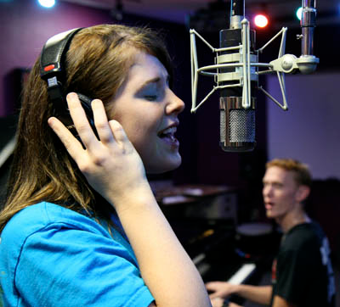

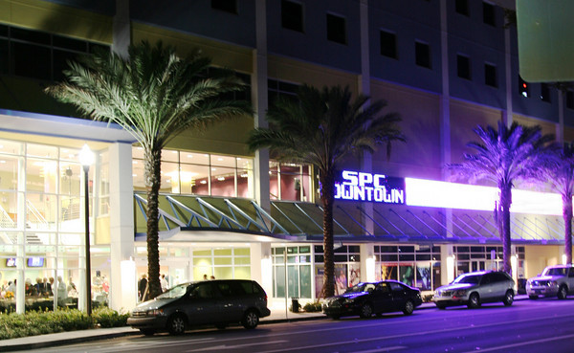
St. Petersburg College
Institutional Context
Notes:
St. Petersburg College (SPC) multi-campus four-year public institution with 10 learning sites throughout Pinellas County ​
32,000 students each year​
22 baccalaureate degrees, 39 associate degrees, 2 workforce diplomas, and 54 workforce certificates. ​
Nearly 72 per cent of SPC students attend school part time. ​
SPC is accredited by the Southern Association of Colleges and Schools.​
​
SPC is presently the largest provider of online education in the Florida College System (FCS), accounting for approximately 10% of all online education offered through the 28 community colleges. For SPC, online courses account for 30% of overall enrollment in fall and spring semesters and more than 50% in summer.

Slide 4
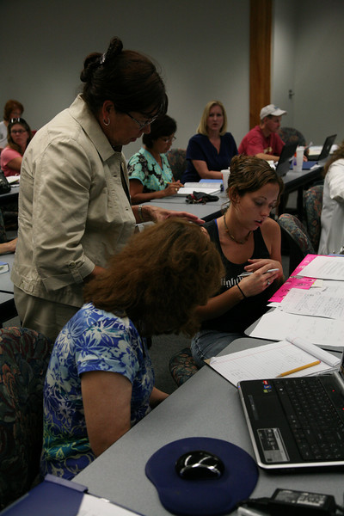
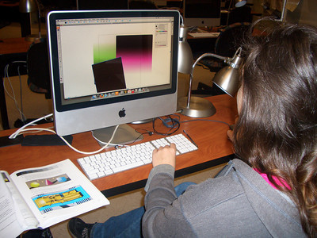
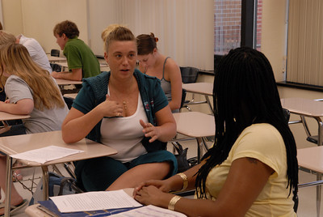
St. Petersburg College
Institutional Context
Steering Forces
Dev. Ed. Reform
Achieving the Dream
Title III Grant
Notes:
Steering Forces​
Dev. Ed. Reform​ SB 1720
Achieving the Dream​ “Achieving the Dream is closing achievement gaps and accelerating student success nationwide”
Title III Strengthening Institutions Program, is funded by the U.S. Department of Education to improve the systems, services and supports necessary to successfully guide students from enrollment to graduation.
”Since receiving a $2.2 million Title III grant on Oct. 1, 2013, St. Petersburg College has made significant steps in its first year toward implementation of the five-year grant, The College Experience: A Pathway from Enrollment to Graduation.”

Slide 5

Institutional Context:
Changing the Culture
Shared Governance
Collaborative Strategies
Transparency
Business Intelligence
Training
WEEKLY WEBINAR – conducted online every Wednesday from 8:30-9 for all employees
New Student Orientation
Integrated Advising & Career Services
My Learning Plan
Early Alert and Student Coaching System
Out of Classroom Support
Notes:
A new era of transparency and data informed decision making

Slide 6


30-minute zombie-themed orientations on research and writing support for Composition I.
Night of the Living Dead clips and graphic novel handouts.
Clicker Survey Results:
  15% increase, from start to finish, in the number who “strongly agreed” that library would help them with classes.
  94% of all students agreed or strongly agreed to having a better understanding of resources in the library.
  85% of students agreed or strongly agreed to enjoying the presentation.

Slide 7
Smart Start Orientation
Student Success and Retention
Smart Start Described:
A non-credit course required for all new, first-time at SPC degree seeking students and students returning from suspension and dismissal
The course is taught by Career & Academic Advisors (using the learning management system)
The course is a 4 week course, two engagements per week (one on campus and one online), 1.5 hours each
Core Curriculum Topics:
Week One: Learning Resources
Week Two: Academic Standing
Week Three: Career Services
Week Four: My Learning Plan

Slide 8

Vision
Proposed Outcomes:
Metacognition
Critical Thinking
Close Reading
Academic Skills
In-Depth Research Skills
Notes:
Heterochromia iridis, or having two different colored eyes, is a good symbol for the difference between our vision for Smart Start. We had one vision, while the course designers had another. We figured 45-minutes with a captive audience – what could be better! Therefore, we had all of these great ideas: let them learn about and perform some close reading…let them think about their thinking…and hone their academic skills in time-management, note-taking, and study skills.

Slide 9

Current Assets
Research.spcollege.edu
LibGuides
PowToons
Dedicated tutors and librarians
Instructional design team
Notes:
Based on UCI Libraries Begin Research Online Workshop Tutorial and has been customized for students of St. Petersburg College. Creative Commons License--Worked well for online, adapted for face to face for live demo
LibGuide Views 2015: Citations 21,088; BSN 8,873; Research Workshop 431.
Challenge of online sections—same curriculum
What could be adapted and put online? What was online that could be used face to face?

Slide 10

Reality On-Campus
Library Orientation
Scavenger Hunt
Tours of Library/Learning Centers
Meet & Greet
Notes:
Scavenge: to find dead and decaying ;)
Make new connections and introduce students to tutors/librarians
Promises and Pitfalls
Time: with captive audience; time lost to create and schedule program
Place: students know where to get help; tied to one campus
Context: know about us from the beginning; no class or assignment to show relevance

Slide 11
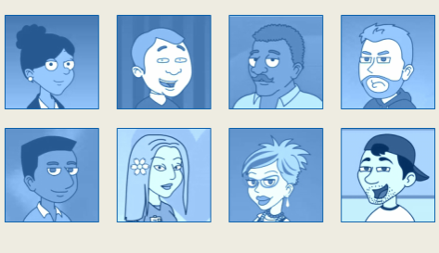
Reality Online
Demo course available for all
Citation tools and live demo
Sample assignment “How to get help”
Online and on campus sorting activity
SmarThinking, Ask a Librarian, SPOT, VLC
Notes:
32 sections at Seminole, 49 at Clearwater

Slide 12
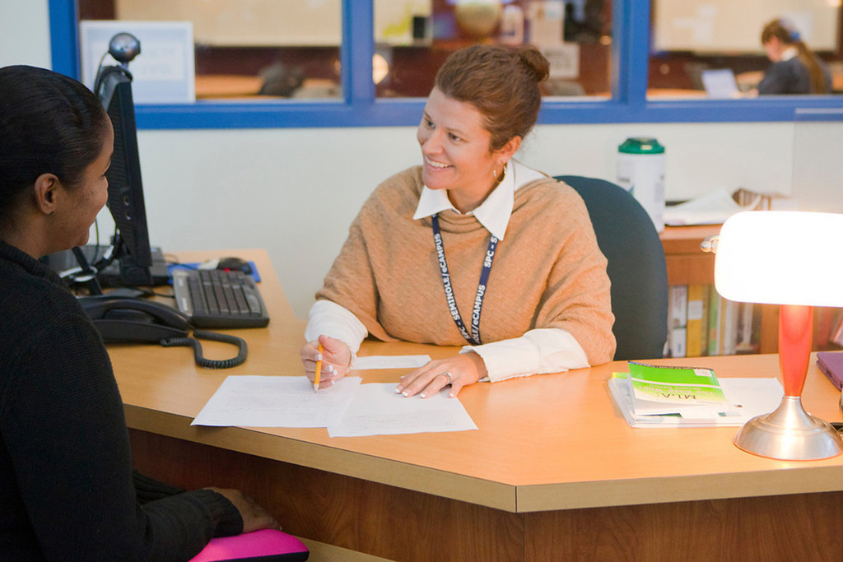
Collateral Outcomes
Deeper connections
Cross-trained staff
Reusable online resources
Educated referrals
Changes to course integrated instruction and tutoring
Fewer MyCourses introduction sessions
Notes:
Know more about what they want, who, when and how
Students have already had library tour/intro

Slide 13
Key Metrics
Smart Start Regular Session Fall Enrollment: 4,294
Fall 2015 | Final Grade | Good Academic Standing | Spring Enrolled
Satisfactory | 89% (3,822) | 67% (3,402) | 81% (3,096)
Unsatisfactory | 11% (472) | 32% (151) | 52% (245)
Smart Start Express Session Fall Enrollment: 815
Fall 2015 | Final Grade | Good Academic Standing | Spring Enrolled
Satisfactory | 71% (576) | 59% (338) | 78% (448)
Unsatisfactory | 29% (239) | 22% (53) | 50% (119)
13
Notes:
Know more about what they want, who, when and how
Students have already had library tour/intro

Slide 14
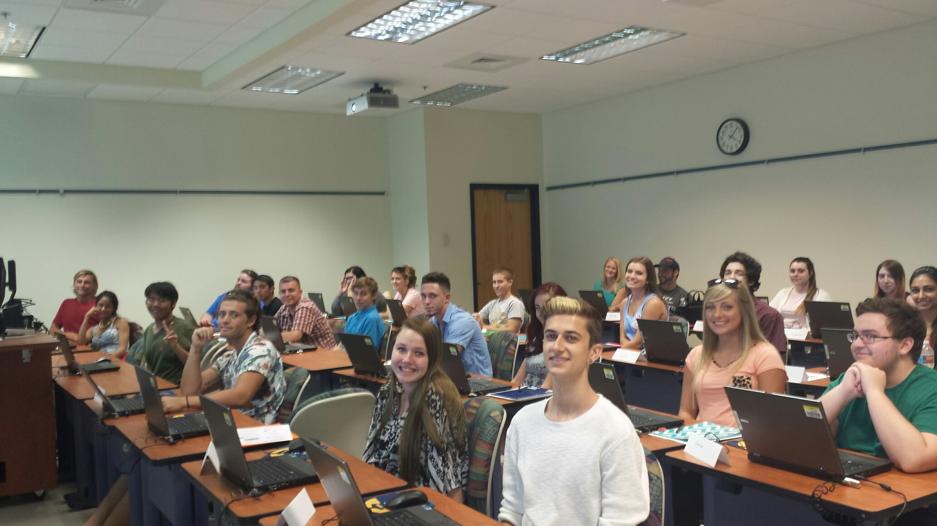
Key Metrics
Source: SPC Business Intelligence and PeopleSoft Student Production December 2015.

Slide 15
Key Metrics
Smart Start Regular Session Spring Enrollment: 2,340
Regular Session Spring 2016 | Final Grade | MLP YES | Learning Support | W/WF | Term Withdrawal
Satisfactory | 79% (1746) | 93% (1625) | 46% (796) | 6% (113) | 1% (16)
Unsatisfactory | 21% (473) | 80% (121) | 30% (142) | 20% (94) | 5% (26)
Smart Start Express Session Spring Enrollment: 365
Regular Session Spring 2016 | Final Grade | MLP YES | Learning Support | W/WF | Term Withdrawal
Satisfactory | 74% (168) | TBD | TBD | TBD | TBD
Unsatisfactory | 26% (60) | TBD | TBD | TBD | TBD
15
15
Notes:
Know more about what they want, who, when and how
Students have already had library tour/intro

Slide 16
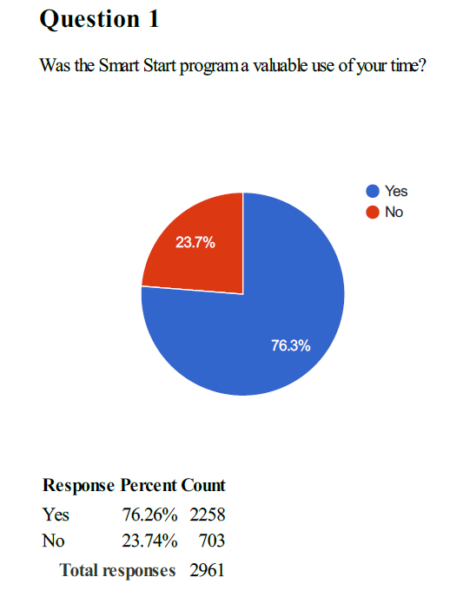
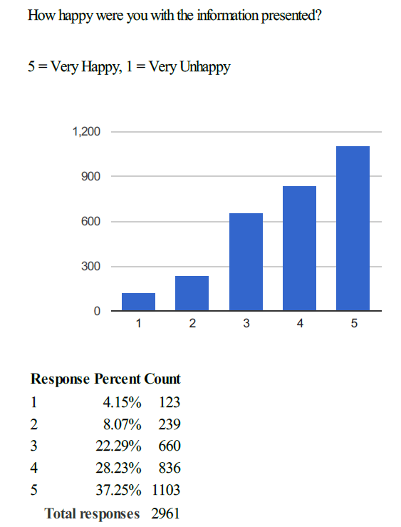
Feedback
Survey results:

Slide 17
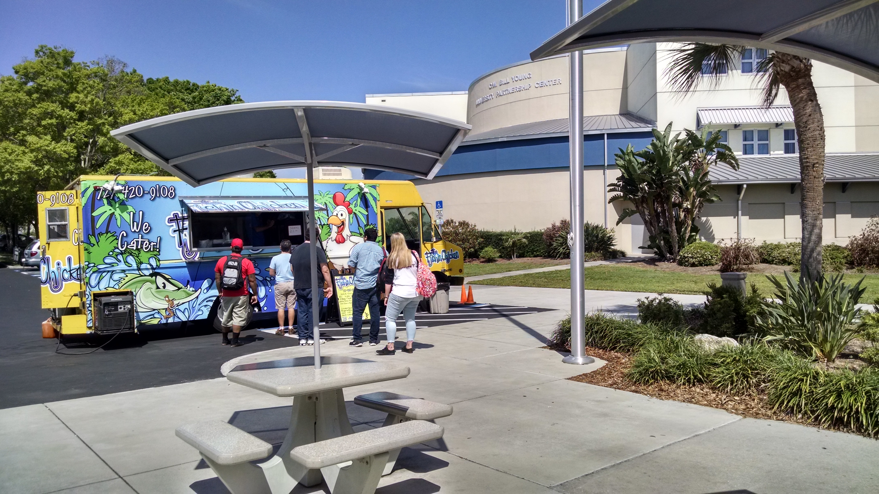
Feedback
Survey results
Is there anything we should add to Smart Start?
57% No changes
Some write-in suggestions:
Allow quicker pace or online version for everyone
Make it optional
Slower with more help in computer literacy
Give credit for the course
Food!
Notes:
Special sections for returning from suspension, dismissal etc.
Cohorts, learning communities, reunion meetings
Advisers as coaches and case managers
Everyone loves the boutique experience--food truck rally something for everyone, customized, mini-experience, variety

Slide 18
Questions?

