Slide 1
Florida Atlantic University The Mentoring Project
Making MAGIC Happen through Mentoring in a Learning Center
Dr. Jennifer Bebergal
FCLCA – April 7, 2016

Slide 2
Agenda
Why mentoring?
“Magical stories” from our mentors and mentees
Mentoring – a function of Academic or Student Affairs? YES!
The Mentoring Project at FAU
Funding our mentoring program – donor grant
Mentor and Tutor Training similarities
Q&A
FCLCA – April 7, 2016

Slide 3
Why Mentoring?
One of only five variables strongly correlated with student persistence (Cuseo, 2014)
URM and first-generation students can benefit from mentoring even more than others as this group can feel marginalized
One of the top strategies in the literature to support first-generation college students and to improve their odds for college completion includes formalized mentoring programs (Coles, 2011; Levine & Nidiffer, 1996)
Mentoring relationships increase one’s sense of personal significance -- “I matter”
Mentoring provides students with connections and a knowledgeable resource
Mentoring helps build tenacity, a student’s ability to monitor their performance and persevere through challenge (Conley, 2007).
FCLCA – April 7, 2016

Slide 4
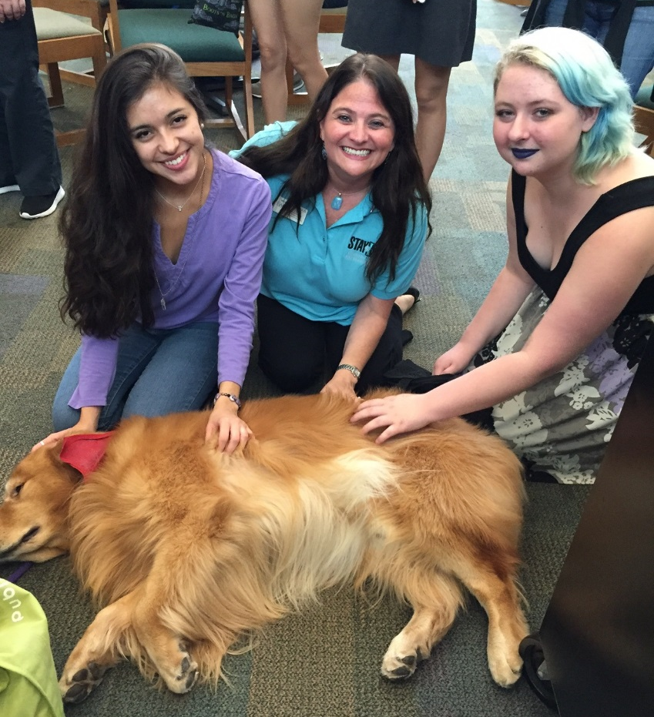
Our Magical Stories
Our Mentor Stories
Our Mentee Stories
Kol the Therapy Dog – Finals week
FCLCA – April 7, 2016

Slide 5
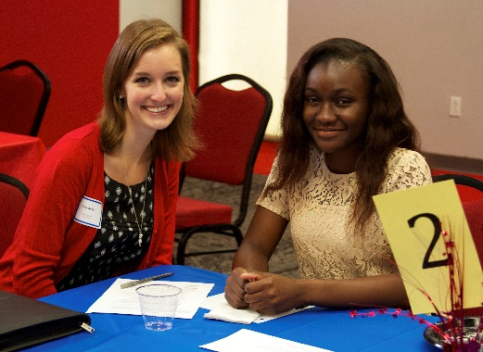
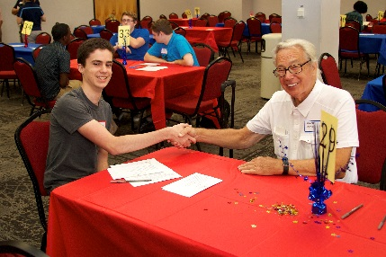
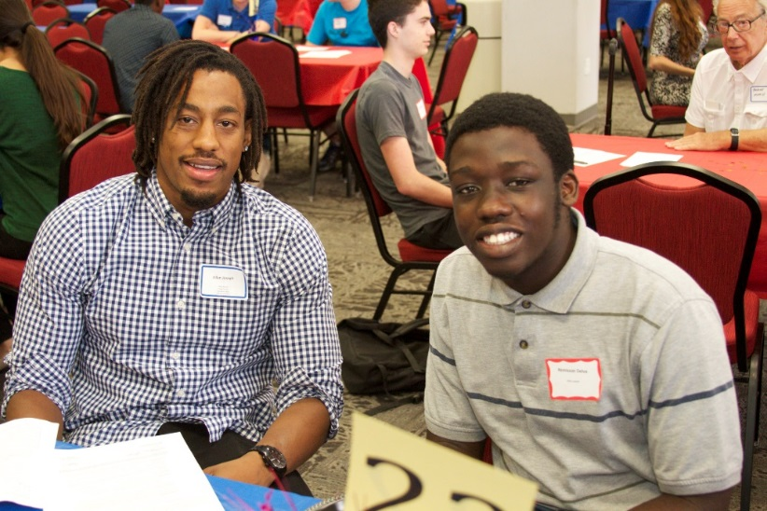
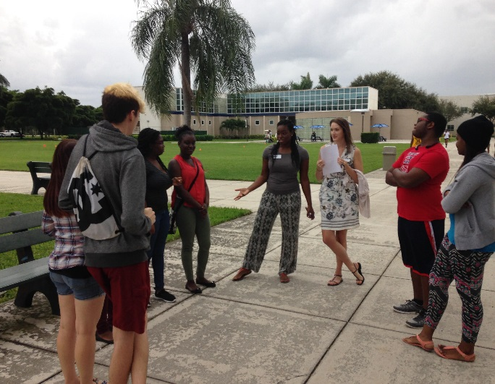
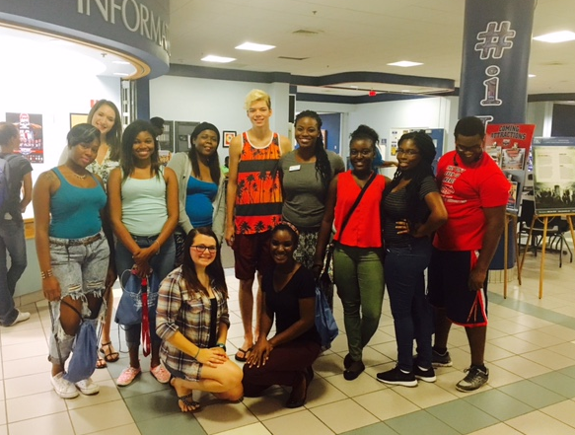
Mentoring Project I.M.P.A.C.T
Who’s Your Match Event
Who’s Your Match Event
Who’s Your Match Event
Who’s Your Match Event
Scavenger Hunt
Scavenger Hunt

Slide 6
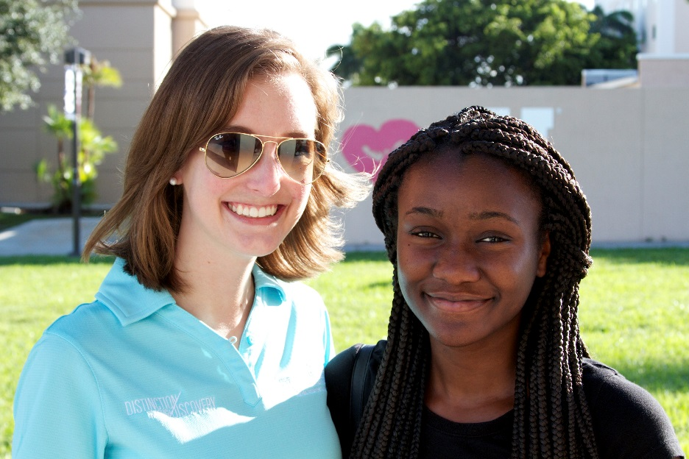
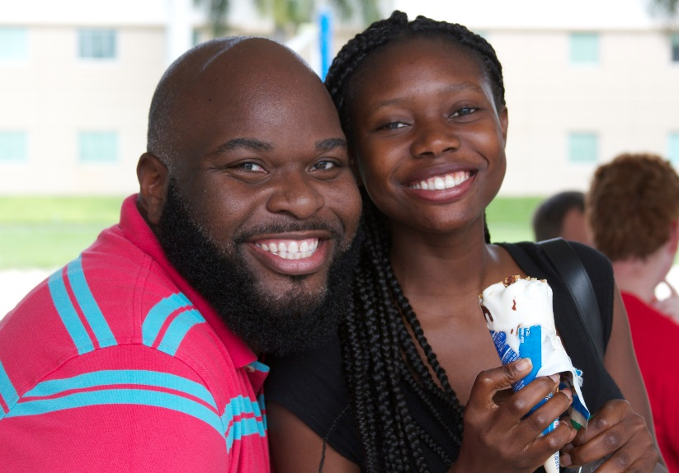
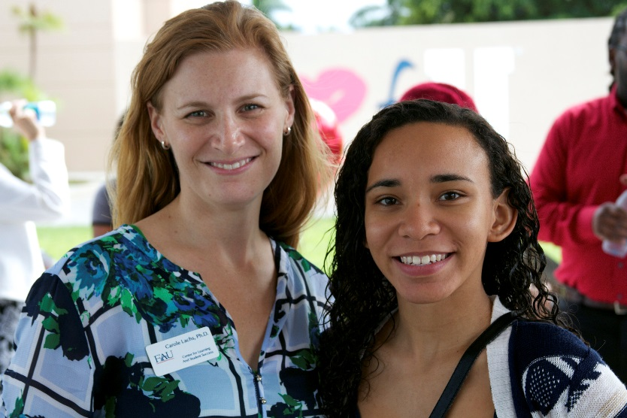
Mentor-Mentee Ice Cream Social

Slide 7
Mentoring Project I.M.P.A.C.T
“Before I met my mentor I was constantly stressed because of all the responsibilities that were thrown on my shoulders. I was working more than I should part-time as a full-time student and my grades were being affected negatively. Then, I heard about the mentoring program, something I was hoping I'd find at FAU. My mentor has impacted me greatly ever since she started working with me. She helped me create a schedule to manage life and school work so my grades and outlook on life have been improving very much.”
-- Naola L., freshman mentee, Biological Sciences
Notes:
“Before I met my mentor I was constantly stressed because of all the responsibilities that were thrown on my shoulders. I was working more than I should part-time as a full-time student and my grades were being affected negatively. Then, I heard about the mentoring program, something I was hoping I'd find at FAU. My mentor has impacted me greatly ever since she started working with me. She helped me create a schedule to manage life and school work so my grades and outlook on life have been improving very much.”
-- Naola L., freshman mentee, Biological Sciences

Slide 8
Rosedale J. – Graduate Student Mentor and her mentee - Naola

Slide 9
Mentoring Project I.M.P.A.C.T
“My mentor is super amazing and we have so much in common…She is very positive and insightful. I think this was a very good match and I can't wait to see what great things come from this experience.”
-- Godshey S., freshman mentee, Social Work
“…I made a great connection with a mentor who is older and has experience and has helped me with my journey through my freshman year.”
-- Jessenia B., freshman mentee, Undeclared
“My mentor and I had an awesome first meeting. I'm confident that us being paired together was a great decision. I'm excited to see what the rest of the year holds for us two!”
-- Rebecca C., freshman mentee, Communication Studies

Slide 10
Where Should Mentoring Reside?
Academic Affairs?
Student Affairs?
Existing mentors in Academic Affairs
Access to recruit faculty/ staff mentors
Peer mentors align with tutor training and supervision
Gain buy-in from academic-side of house
Existing mentors in Student Affairs
Access to recruit peer mentors and mentees
Gain buy-in from student-affairs-side of house
BOTH!
FCLCA – April 7, 2016

Slide 11
The Mentoring Project (TMP) @ FAU
Funded through $764,000+ grant from a private donor foundation over 3 years
Commitment from FAU to pick up all aspects of the grant at conclusion of funding
STAFFING (Academic Affairs: AA; Student Affairs: SA)
Co-Director for Faculty/Staff Mentoring (AA)
Co-Director for Peer/Student Mentoring (SA)
TMP Assistant (AA)
3 Graduate Assistants (mix AA and SA)
www.fau.edu/mentoringproject/
FCLCA – April 7, 2016

Slide 12
The Mentoring Project (TMP) @ FAU
MISSION: To promote student success by increasing student engagement through mentoring programs.
VISION: Creating a campus environment where all students can confidently state who their mentor is and how mentoring has impacted their student success at FAU.
VALUE STATEMENT: The Mentoring Project values IMPACT - Integrity, Mutuality, Patience, Authenticity, Collaboration, and Trust.
GOALS: To foster a sense of belonging to the FAU community
To help build strong mentor-mentee relationships
To encourage participation in campus events, student clubs, research and internships
To connect students with campus resources and academic support services
www.fau.edu/mentoringproject/
FCLCA – April 7, 2016

Slide 13
Austen K – Graduate Student Mentor

Slide 14
The Mentoring Project (TMP) @ FAU
TMP as the umbrella
Connections
The Mentoring Council
Mission Statement
22 programs across FAU joined
www.fau.edu/mentoringproject/
FCLCA – April 7, 2016

Slide 15
Connections – YEAR 1 (2015-2016)
Development of all processes and publications
Recruitment, Matching, Orientation/Training, Match Support and Assessment/Evaluation
Built and launched the program for mentors AND mentees
INITIAL FALL 2015 COHORT
Mentors (187) Mentees (464)
• Faculty/Staff (167) • FTIC (438)
• Peer (17) • STEM (110)
• TMP GAs (3) • URM (271) • 1st gen (88)

Slide 16
Connections – Faculty/Staff Incentives
Recognition letter to supervisor/department chair/dean
Coffee with mentee on us
Referral incentives (lunch on us)
End-of-Year awards and certificates
NEW: Provost approved recognition of mentoring activities for faculty under F.A.I.R. information reporting system

Slide 17
Connections – Faculty/Staff Training
Orientation; Mentor Manual
Monthly workshops
Mentoring for Success: Appreciative Mentoring
Title IX & Victim Advocate (To tell or not to tell)
Stress Management & Wellness
Establishing Rapport & Connecting with Mentees
Mentor “Mixer” (exchange of ideas, stories, best practices)
Mentor Newsletters

Slide 18
Mentoring Project I.M.P.A.C.T. on Mentors
“It is an honor to serve as a mentor in S.T.E.M. fields of study, particularly computer science and engineering. I am passionate about the young women entering the university and enjoy the opportunity to not only serve as a role model but also to learn from the young exceptional students in the mentoring program.”
-- Tami S., faculty mentor, College of Engineering and Computer Science

Slide 19
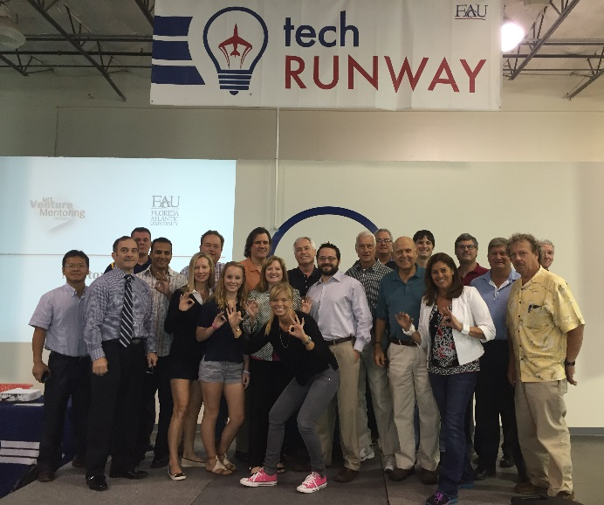
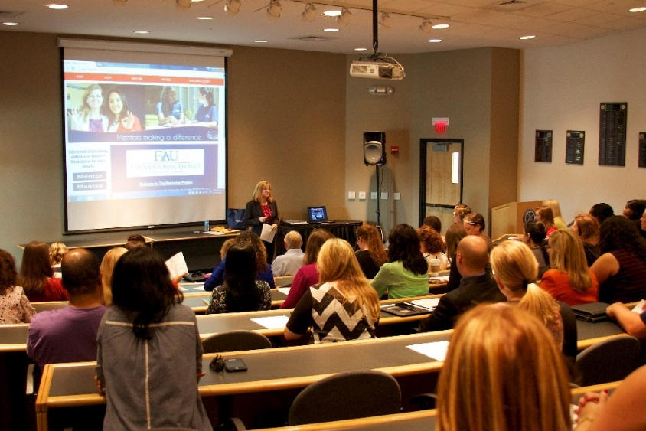
Connections - Professional Development
“It helps for me to attend the mentor trainings because most of my mentors have class during that time and cannot attend. I look forward to sharing with them some of the useful information/tips I gather from these trainings.”
-- Sylvanna F., member, Mentoring Council
Mentor Orientation
Mentor Training

Slide 20
Mentoring Project I.M.P.A.C.T –
Peer Mentors
“I joined Connections since I wanted to give back to a student...I wanted to help a student through some of the challenges I know they will face. Experience brings wisdom and if I could make another student's academic journey a little easier with support and help then my goal [for] this program is met.”
-- Niccola P., peer mentor, Health & Wellness

Slide 21
Connections – Peer Mentor Training
Peer Mentors must have:
60 credits with 3.0
Successfully complete an application, interview, and 2 reference checks
TRAINING is based on CRLA – IMTPC guidelines
Core Training – Peer Mentor Training Academy (2 days)
LEVEL 1 plus electives/Level 2 topics as appropriate
Specific topics for our population such as cultural awareness
Training Manual
Ongoing trainings
Future: may develop this into a class
https://www.crla.net/index.php/certifications/imtpc-international-mentor-training-program

Slide 22
CRLA Training for Mentors and Tutors
What links can you find?
How can we partner?

Slide 23
Connections - Assessment & Evaluation
Monthly Check-in Form
Mentor Training Surveys
Mentee Outcomes Survey (pre- post-)
Match Characteristics Questionnaire
Exit Survey

Slide 24
Challenges
Recruitment => Time frame; reaching our target student group
Matching => Time allocation and time frame
Match Support => Volume
GA => Case Load (mentees)
Administration => SA/AA partnership great in theory, challenge in practice

Slide 25
Jenna T. – first-year Elementary Education major

Slide 26
Questions?

